Slide 1
Map Interface in Java

Slide 2
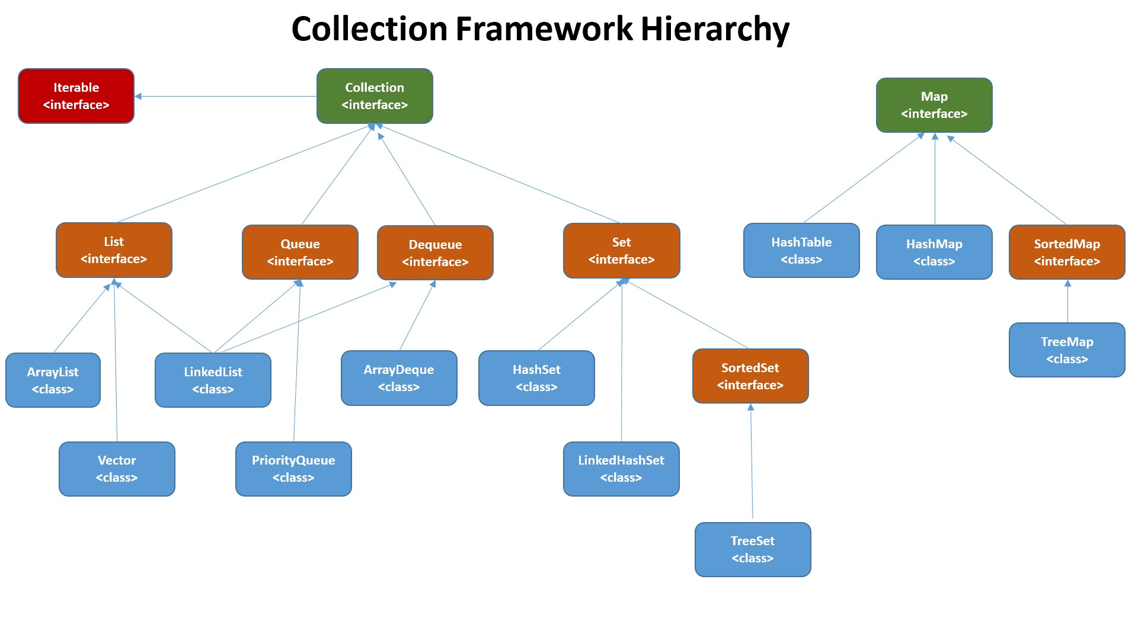

Slide 3
What is a Map in Java?
Map in Java behaves like a dictionary in real world.
Map maintains keys and value pairs.
Once stored in a Map, you can later look the value just using the key.
Map interface can be found in java.util.Map.

Slide 4

A Real World Scenario

Slide 5
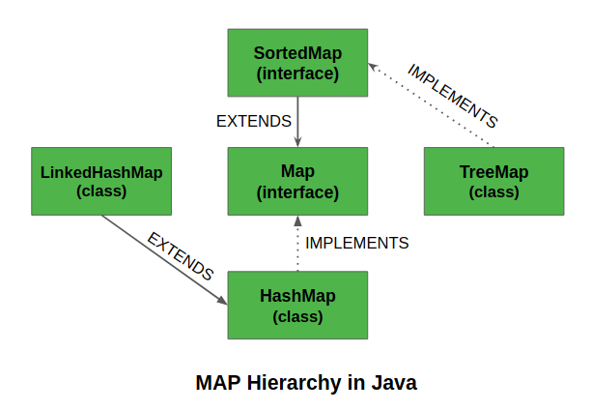
How to use Map in Java?
Since Map is an interface, we need to implement the methods provided inside it.
Java provides the following
implementation classes in Map-
HashMap
LinkedHashMap extends HashMap
SortedMap<interface>

Slide 6
HashMap in Java
Declaring a HashMap in Java uses the following syntax-
HashMap<Object, Object> mapName = new HashMap<>();
Storing values in HashMap –
mapName.put(key, value);
Retrieving values from HashMap-
mapName.get(key);

Slide 7
Some other functions in HashMap
void clear()
boolean isEmpty()
remove(Object key)
boolean containsValue(Object value)
boolean containsKey(Object key)
int size()
boolean equals(Object o)

Slide 8
Iterating over HashMap
Key iterator
Iterator iterator = mapA.keyset().iterator();
while(iterator.hasNext())
{
Object key = iterator.next();
Object value = mapA.get (key);
}
For-each Loop
for(Object key : mapA.keyset())
{
Object value = mapA.get (key);
}

Slide 9
SortedMap in Java
SortedMap provides total ordering of elements.
The implementation class for SortedMap is TreeMap.
Declaring a SortedMap in JAVA-
SortedMap<Object, Object> mapName = new TreeMap<>();
TreeMap can be used to sort a HashMap based on keys.

Slide 10
Conclusion
Collection in java is a group of objects.
Collection framework includes interfaces - Set, List and Queue.
Collections is a utility class in Java.
Java Collection framework gives prepackaged data structures and algorithms for manipulating them.

Slide 11
Thank You!

